Slide 1
Color restoration method for underwater objects based on multispectral images

Slide 2
Color restoration method
Overview
Introduction
Experiment setup & Method
Results
Conclusion

Slide 3
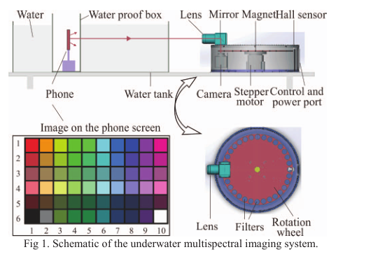
Eliminate the scattering and absorption&Color restoration
Overview

Slide 4
Color restoration method
Overview
Introduction
Experiment setup & Method
Results
Conclusion

Slide 5
Introduction
1. The importance of obtaining underwater color image
2. The challenge of attenuation and absorption (Turn green)
3. Some methods and theories of current color restoration

Slide 6
Color restoration method
Overview
Introduction
setup & Method
Results
Conclusion

Slide 7
setup & Method
Underwater multispectral imaging system
Image collection & processing
Underwater multispectral image restoration
Real color image restoration

Slide 8
Underwater multispectral imaging system

Slide 9
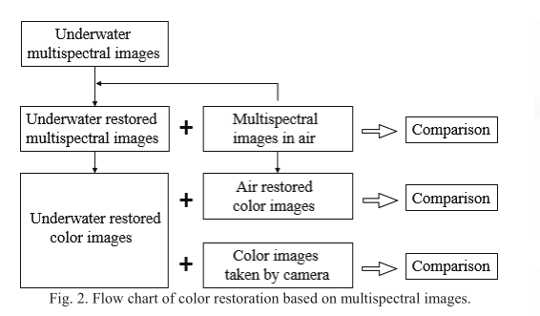
Image collection & processing
Mainly to obtain underwater multispectral images, multi spectral images in the air, the air in the camera image

Slide 10
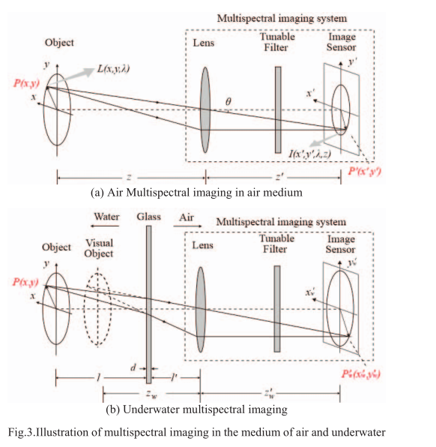
Underwater multispectral image restoration

Slide 11
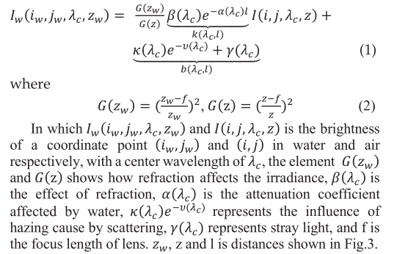
According to geometrical optics theory and Jaffe-
McGlamery approach [7 - 8], relationship between brightness of image in air and water medium can be deduced as:

Slide 12
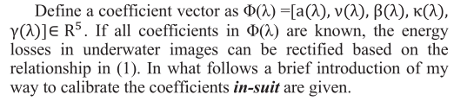
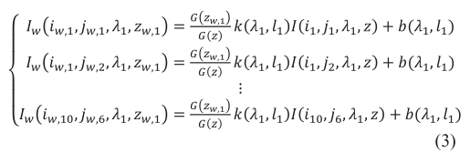
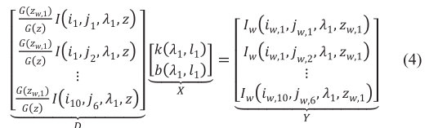

For 60 images:
写成矩阵
应有1？

Slide 13
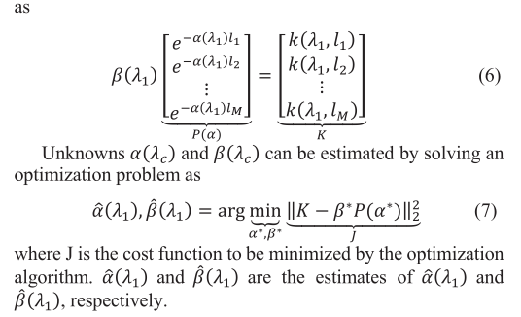

Slide 14
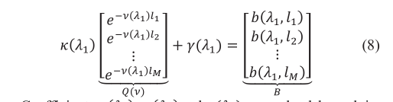
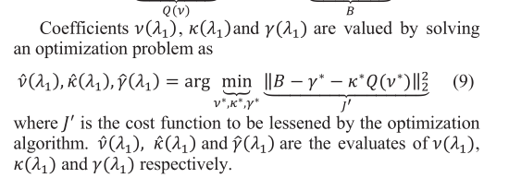
我认为应该没有l参数

Slide 15
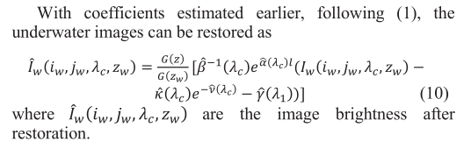

与作者推出结果不同

Slide 16
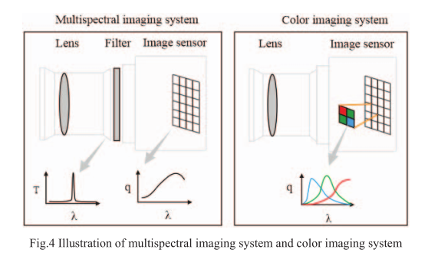
Real color image restoration
The multispectral imaging system is differ from color imaging system on the phenomenon of splitting of light.

Slide 17




For color imaging system
避免曝光
For multispectral imaging system
避免曝光
can be seen as a impulse function at its center wavelength λ(c)

Slide 18


For the reason q(λ c)and T(λ c)vary with wavelength, the obtained spectrum is distorted by them:(where Is(x,y, λ c)is the corrected spectral intensity)
Then the corrected spectrum is linear interpolated with the algorithm will be

Slide 19
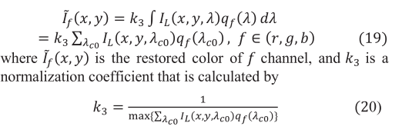
Finally the color restoration is achieved by simulating the image processing in (13), namely, calculating the color response by:

Slide 20
Color restoration method
Overview
Introduction
setup & Method
Results
Conclusion

Slide 21
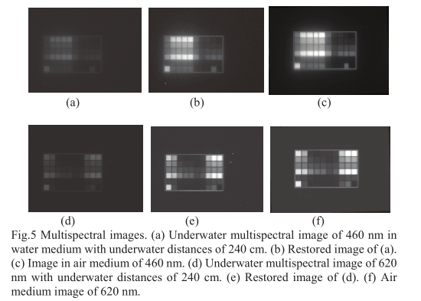
Results
L and T

Slide 22
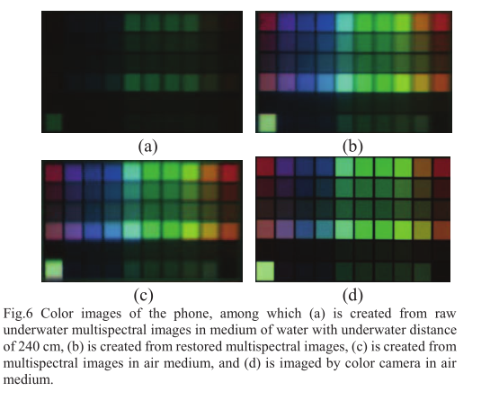

Slide 23
Learning and Transferring
Overview
Introduction
setup & Method
Results
Conclusion

Slide 24
Conclusion
Firstly, an underwater multispectral image restoration method is proposed to eliminate the disturbance by water, with the restoration residual and relative residual being calculated as 0.02 and 5.25% on average, respectively. Real color images are restored from the underwater multispectral images by a real color restoration algorithm.

